Slide 1
ASHG 2019 Conference
ShapeIT(1-4), not a Haplotype Assembly software package
Princess: Detects and phases SNPs and SVs
Alignment: NGMLR & minimap2
Phasing: WhatsHap
Converts SNVs to SVs: CrossStitch
Methylation
4 in 1 software package
Common Data sets used: HG002, NA12878, PGP-1

Slide 2
Data sets
PGP-1: https://pgp.med.harvard.edu/
Data set access: https://pgp.med.harvard.edu/data & https://my.pgp-hms.org/public_genetic_data
THE PGP IS NOT A TRADITIONAL RESEARCH STUDY:
Starting in 2005 as a pilot experiment with 10 individuals, the Harvard Personal Genome Project (Harvard PGP) pioneered a new form of genomics research. The main goal of the project is to allow scientists to connect human genetic information (human DNA sequence, gene expression, associated microbial sequence data, etc) with human trait information (medical information, biospecimens and physical traits) and environmental exposures.
Project participants consent to provide biological samples from themselves in order to perform whole genome sequencing, and use of these materials for biological research. The project now has over 5,000 participants.
GIAB: HG001, HG002, …, HG007:
Access: https://github.com/genome-in-a-bottle/giab_latest_release
The Genome in a Bottle (GIAB) Consortium is a public-private-academic consortium hosted by NIST to develop the technical infrastructure (reference standards, reference methods, and reference data) to enable translation of whole human genome sequencing to clinical practice. The priority of GIAB is authoritative characterization of human genomes for use in analytical validation and technology development, optimization, and demonstration. In 2015, NIST released the pilot genome Reference Material 8398, which is genomic DNA (NA12878) derived from a large batch of the Coriell cell line GM12878, characterized for high-confidence SNPs, indel, and homozygous reference regions (Zook, et al., Nature Biotechnology 2014 and Zook, et al., Nature Biotechnology 2019).
HG002-HG004: Son, Father & Mother trio set (AshkenazimTrio)
HG005-HG007: Son, Father & Mother trio set (ChineseTrio)

Slide 3
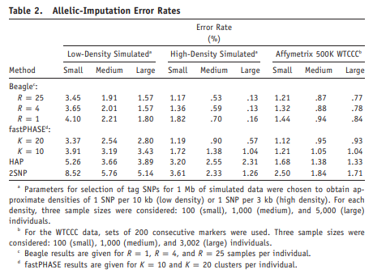
MIHA Software Package
BEAGLE, 2007: Rapid and Accurate Haplotype Phasing and Missing-Data Inference for Whole-Genome Association Studies By Use of Localized Haplotype Clustering
https://www.ncbi.nlm.nih.gov/pmc/articles/PMC2265661/pdf/AJHGv81p1084.pdf

Slide 4
MIHA Software Package
MaCH (2010): Using Sequence and Genotype Data to Estimate Haplotypes and Unobserved Genotypes
Paper:https://www.ncbi.nlm.nih.gov/pmc/articles/PMC3175618/pdf/nihms314089.pdf
Access: http://csg.sph.umich.edu/abecasis/MACH/
See next page for haplotyping description

Slide 5
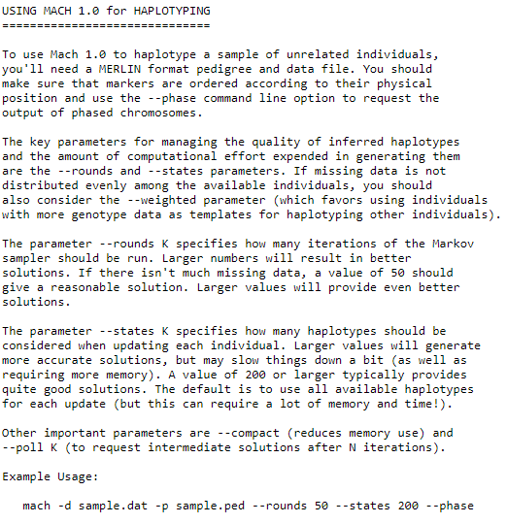
MaCH, 2010: obtained from: http://csg.sph.umich.edu/abecasis/MACH/tour/

Slide 6
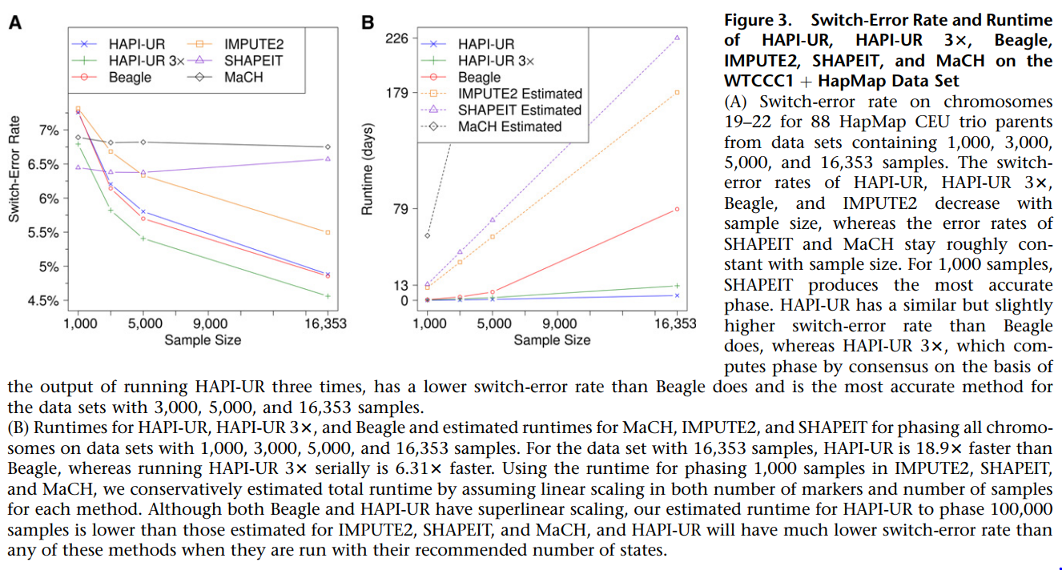
MIHA Software Package
HAPI-UR, 2012: Phasing of Many Thousands of Genotyped Samples
https://www.ncbi.nlm.nih.gov/pmc/articles/PMC3415548/pdf/main.p
Access: https://code.google.com/archive/p/hapi-ur/
Method for inferring haplotype phase from genotypes for very large datasets of between 1,000 to 200,000 genotyped individuals

